Slide 1
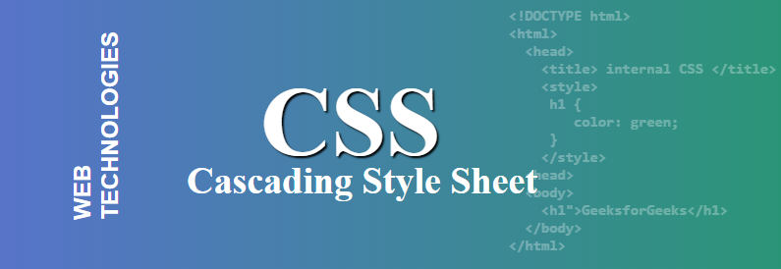

Slide 2
CSS: CASCADING STYLE SHEETS
Cascading Style Sheets (CSS) is a stylesheet language used to describe the presentation of a document written in HTML or XML (including XML dialects such as SVG, MathML or XHTML). CSS describes how elements should be rendered on screen, on paper, in speech, or on other media.
CSS is among the core languages of the open web and is standardized across Web browsers according to W3C specifications. Previously, development of various parts of CSS specification was done synchronously, which allowed versioning of the latest recommendations. You might have heard about CSS1, CSS2.1, CSS3. However, CSS4 has never become an official version.
From CSS3, the scope of the specification increased significantly and the progress on different CSS modules started to differ so much, that it became more effective to develop and release recommendations separately per module. Instead of versioning the CSS specification, W3C now periodically takes a snapshot of the latest stable state of the CSS specification.

Slide 3
Types of CSS (Cascading Style Sheet)
Difficulty Level : easy
Last Updated : 30 Jun, 2022
Cascading Style Sheet(CSS) is used to set the style in web pages that contain HTML elements. It sets the background color, font-size, font-family, color, … etc property of elements on a web page.
There are three types of CSS which are given below:
Inline CSS
Internal or Embedded CSS
External CSS

Slide 4
ADVANTAGES OF CSS
CSS saves time − You can write CSS once and then reuse same sheet in multiple HTML pages. You can define a style for each HTML element and apply it to as many Web pages as you want.
Pages load faster − If you are using CSS, you do not need to write HTML tag attributes every time. Just write one CSS rule of a tag and apply it to all the occurrences of that tag. So less code means faster download times.
Easy maintenance − To make a global change, simply change the style, and all elements in all the web pages will be updated automatically.
Superior styles to HTML − CSS has a much wider array of attributes than HTML, so you can give a far better look to your HTML page in comparison to HTML attributes.
Multiple Device Compatibility − Style sheets allow content to be optimized for more than one type of device. By using the same HTML document, different versions of a website can be presented for handheld devices such as PDAs and cell phones or for printing.
Global web standards − Now HTML attributes are being deprecated and it is being recommended to use CSS. So its a good idea to start using CSS in all the HTML pages to make them compatible to future browsers.

Slide 5


